Slide 1
Cryptor
A New Toolset for Writing Windows Based Self-Encrypting Malware

Slide 2
Fundamentals of self encrypting malware
-- Definition
Self-Encrypting malware: Malware which relies on cryptographic functions to obfuscates and or secures some portion of the executable code and/or a set of instructions within an executable file to counteract static analysis.

Slide 3
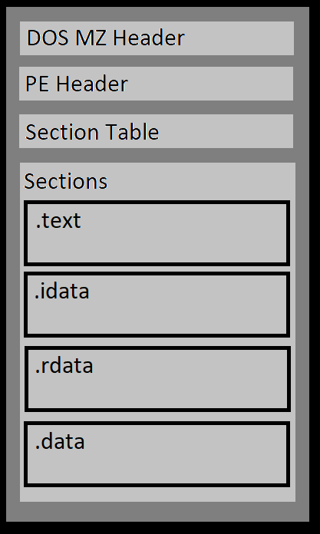
Setting a baseline of normal
The portable executable file format is fairly standardized - DOS MZ Header (Legacy)

Slide 4
Setting a baseline of normal
The portable executable file format is fairly standardized - DOS MZ Header (Legacy)
- PE (Portable Executable) Header

Slide 5
Setting a baseline of normal
The portable executable file format is fairly standardized - DOS MZ Header (Legacy)
- PE (Portable Executable) Header
- Section table

Slide 6
Setting a baseline of normal
The portable executable file format is fairly standardized - DOS MZ Header (Legacy)
- PE (Portable Executable) Header
- Section table
- Sections

Slide 7
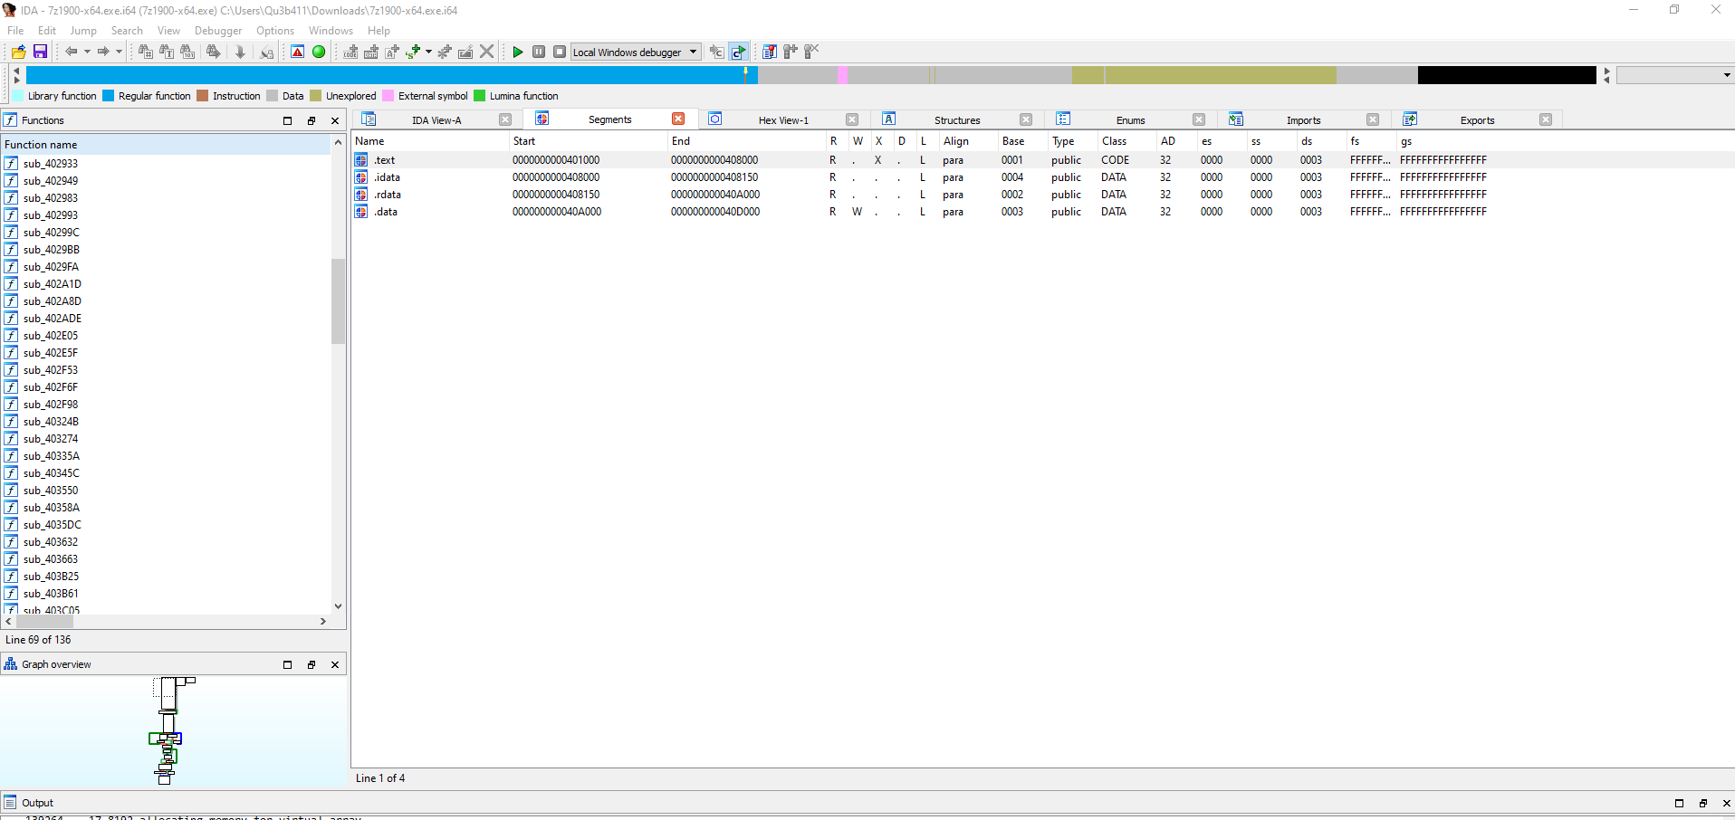
Setting a baseline of normal

Slide 8
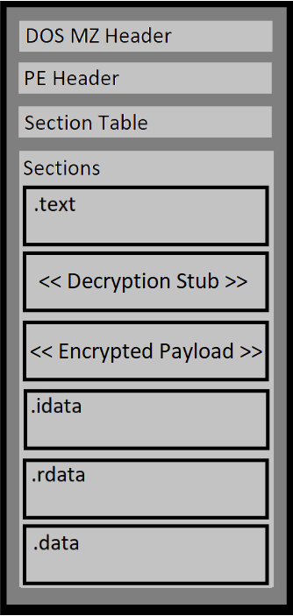
Let’s discuss self encrypting malware
For our use case we add two additional segments
A detryption stub

Slide 9
Let’s discuss self encrypting malware
For our use case we add two additional segments
A detryption stub
The decryption stub is composed of c constructors

Slide 10
Let’s discuss self encrypting malware
For our use case we add two additional segments
A detryption stub
The decryption stub is composed of c constructors
__attribute__((constructor))

Slide 11
Let’s discuss self encrypting malware
For our use case we add two additional segments
A detryption stub
The decryption stub is composed of c constructors
__attribute__((constructor))
The encrypted payload

Slide 12
Let’s discuss self encrypting malware
For our use case we add two additional segments
A detryption stub
The decryption stub is composed of c constructors
__attribute__((constructor))
The encrypted payload
Heuristics for the encrypted payload

Slide 13
Let’s discuss self encrypting malware
For our use case we add two additional segments
A detryption stub
The decryption stub is composed of c constructors
__attribute__((constructor))
The encrypted payload
Heuristics for the encrypted payload
Section Permissions: Readable, writable, executable

Slide 14
Let’s discuss self encrypting malware
For our use case we add two additional segments
A detryption stub
The decryption stub is composed of c constructors
__attribute__((constructor))
The encrypted payload
Heuristics for the encrypted payload
Section Permissions: Readable, writable, executable
Contents of section are detected primarily as data

Slide 15
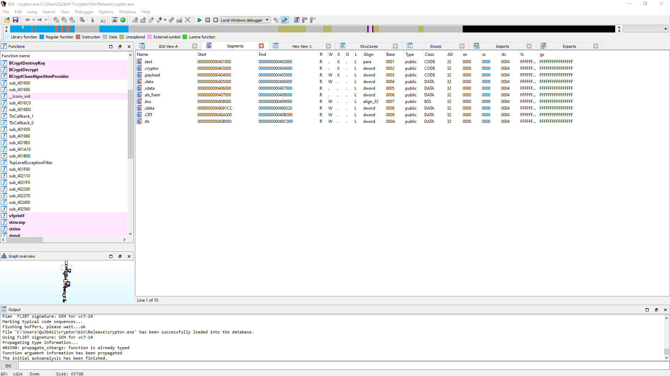
Let’s discuss self encrypting malware
Baseline of norma

Slide 16
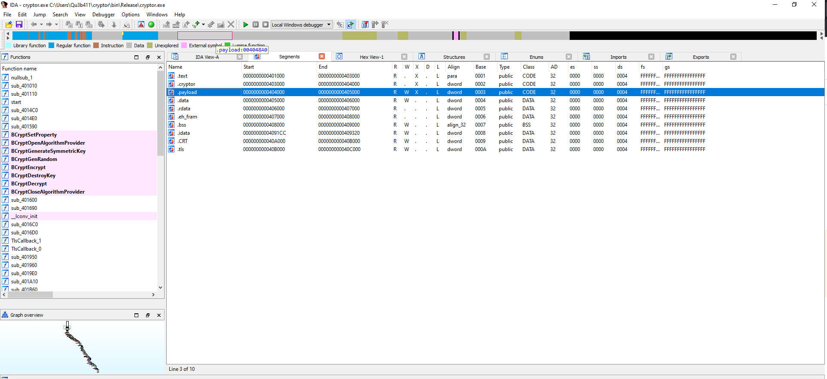
Let’s discuss self encrypting malware
Baseline of norma

Slide 17
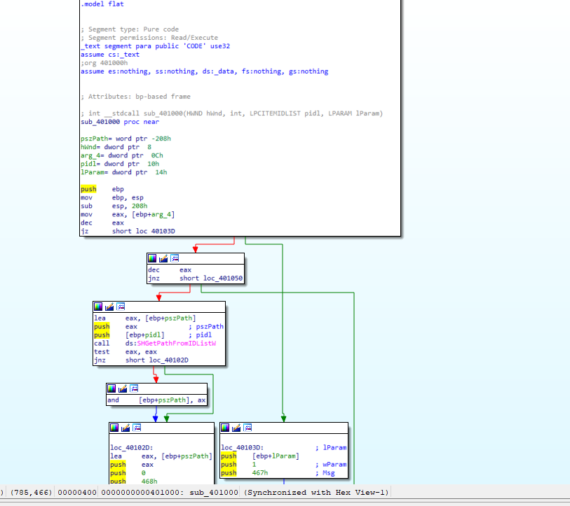
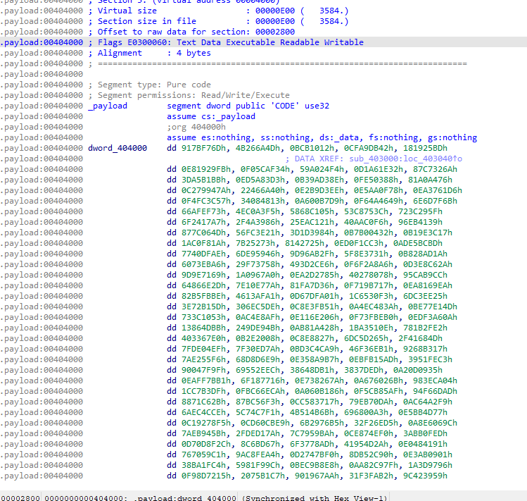
Comparisons
7z.exe (.text)
Cryptor.exe (.payload)

Slide 18
Requirements for writing self encrypting malware
The address of the payload section

Slide 19
Requirements for writing self encrypting malware
The address of the payload section
The size of the payload

Slide 20
Requirements for writing self encrypting malware
The address of the payload section
The size of the payload
To create an rwx section in our portable executable

Slide 21
Requirements for writing self encrypting malware
The address of the payload section
The size of the payload
To create an rwx section in our portable executable
We first need to create a “.payload” section

Slide 22
Requirements for writing self encrypting malware
The address of the payload section
The size of the payload
To create an rwx section in our portable executable
We first need to create a “.payload” section
Use the makefile to modify the flags

Slide 23
Requirements for writing self encrypting malware
The address of the payload section
The size of the payload
To create an rwx section in our portable executable
We first need to create a “.payload” section
Use the makefile to modify the flags
Encrypt the .payload section

Slide 24
Requirements for writing self encrypting malware
The address of the payload section
The size of the payload
To create an rwx section in our portable executable
We first need to create a “.payload” section
Use the makefile to modify the flags
Encrypt the .payload section
Write a decryption stub

Slide 25
The address of the payload section
Specify a custom linker script

Slide 26
The address of the payload section
Specify a custom linker script
Get the default linker script ld --verbose >>OurLinker.ld

Slide 27
The address of the payload section
Specify a custom linker script
Get the default linker script ld --verbose >>OurLinker.ld
Modify the linker script to include the correct sections

Slide 28
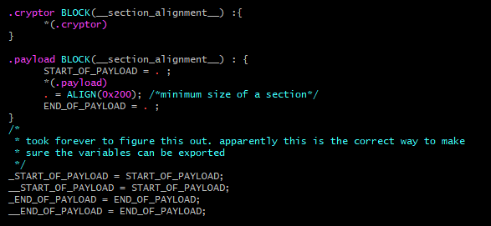
The address of the payload section
Specify a custom linker script
Get the default linker script ld --verbose >>OurLinker.ld
Modify the linker script to include the correct sections

Slide 29
The address of the payload section
Specify a custom linker script
Get the default linker script ld --verbose >>OurLinker.ld
Modify the linker script to include the correct sections
Compile are binary with the custom linker script gcc -T (OurLinker.ld)

Slide 30


The address of the payload section
Specify a custom linker script
Get the default linker script ld --verbose >>OurLinker.ld
Modify the linker script to include the correct sections
Compile are binary with the custom linker script gcc -T (OurLinker.ld)

Slide 31
The size of the payload
Import external symbols

Slide 32
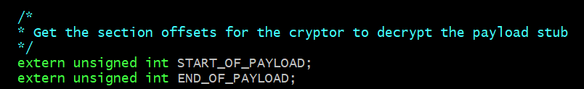
The size of the payload
Import external symbols

Slide 33
The size of the payload
Import external symbols
De-reference external pointers

Slide 34

The size of the payload
Import external symbols
De-reference external pointers

Slide 35
The size of the payload
Import external symbols
De-reference external pointers
Do Basic math

Slide 36

The size of the payload
Import external symbols
De-reference external pointers
Do Basic math

Slide 37
To Create a rwx section in our portable executable

Slide 38
To Create a rwx section in our portable executable
The easy part (Setting the writable flag on the .payload section)

Slide 39
To Create a rwx section in our portable executable
The easy part (Setting the writable flag on the .payload section)
Objcopy --set-section-flags

Slide 40
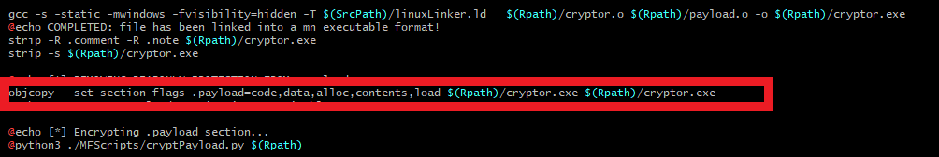
To Create a rwx section in our portable executable
The easy part (Setting the writable flag on the .payload section)
Objcopy --set-section-flags

Slide 41
To Create a rwx section in our portable executable
The easy part (Setting the writable flag on the .payload section)
Objcopy --set-section-flags
Now to define a “.payload” Section

Slide 42
To Create a rwx section in our portable executable
Defining the “.Payload” section

Slide 43
To Create a rwx section in our portable executable
Defining the “.Payload” section
Functions can be given different attributes using the __attribute__ decorator

Slide 44
To Create a rwx section in our portable executable
Defining the “.Payload” section
Functions can be given different attributes using the __attribute__ decorator
Function attributes allows for the specification of sections other then ”.text”

Slide 45
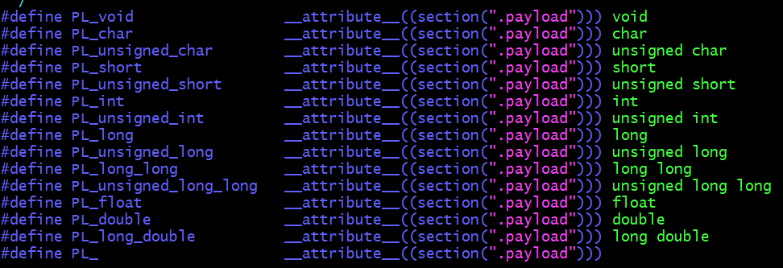
To Create a rwx section in our portable executable
Defining the “.Payload” section
Functions can be given different attributes using the __attribute__ decorator
Function attributes allows for the specification of sections other then ”.text”

Slide 46
To Create a rwx section in our portable executable
Defining the “.Payload” section
Functions can be given different attributes using the __attribute__ decorator
Function attributes allows for the specification of sections other then ”.text”
A slight problem with the data section

Slide 47
To Create a rwx section in our portable executable
Defining the “.Payload” section
Functions can be given different attributes using the __attribute__ decorator
Function attributes allows for the specification of sections other then ”.text”
A slight problem with the data section
Strings

Slide 48
To Create a rwx section in our portable executable
Defining the “.Payload” section
Functions can be given different attributes using the __attribute__ decorator
Function attributes allows for the specification of sections other then ”.text”
A slight problem with the data section
Strings
Solution, Stack strings

Slide 49

To Create a rwx section in our portable executable
Defining the “.Payload” section
Functions can be given different attributes using the __attribute__ decorator
Function attributes allows for the specification of sections other then ”.text”
A slight problem with the data section
Strings
Solution, Stack strings

Slide 50
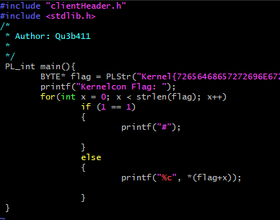
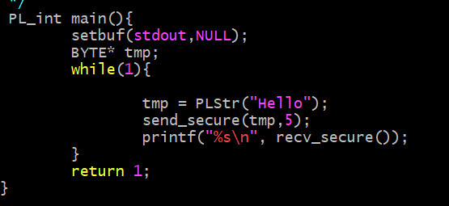
To Create a rwx section in our portable executable
Example

Slide 51
Encrypt the .payload section
Calculate Size and offset of payload section (raw file)

Slide 52
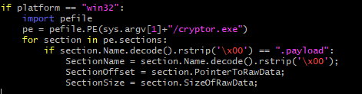
Encrypt the .payload section
Calculate Size and offset of payload section (raw file)

Slide 53
Encrypt the .payload section
Calculate Size and offset of payload section (raw file)
Read section data, Encrypt it, and write it back to the disk

Slide 54
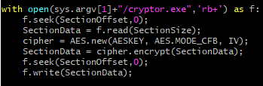
Encrypt the .payload section
Calculate Size and offset of payload section (raw file)
Read section data, Encrypt it, and write it back to the disk

Slide 55
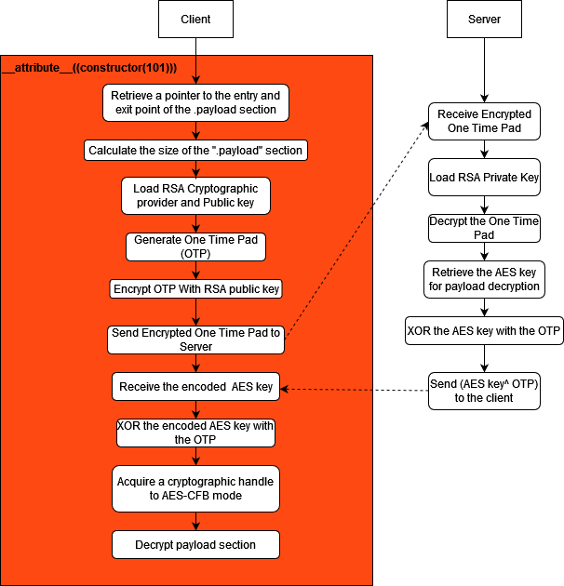
Decryption stub Protocol

Slide 56
Write a decryption stub
Given
The IV

Slide 57
Write a decryption stub
Given
The IV
The AES key

Slide 58
Write a decryption stub
Given
The IV
The AES key
A pointer to the start of the “.Payload”

Slide 59
Write a decryption stub
Given
The IV
The AES key
A pointer to the start of the “.Payload”
The size of “.payload”

Slide 60
Write a decryption stub
Given
The IV
The AES key
A pointer to the start of the “.Payload”
The size of “.payload”
Decryption is…

Slide 61
Write a decryption stub
Given
The IV
The AES key
A pointer to the start of the “.Payload”
The size of “.payload”
Decryption is… Still difficult, Microsoft bcrypt library == PAIN

Slide 62

Write a decryption stub
Given
The IV
The AES key
A pointer to the start of the “.Payload”
The size of “.payload”
Decryption is… Still difficult, Microsoft bcrypt library == PAIN

Slide 63
Decryption Stub Implementation of Cryptor
Bug fix for windows to import a public key

Slide 64
Decryption Stub Implementation of Cryptor
Bug fix for windows to import a public key
CryptImportKeyInfoEx2 Symbol was not exported properly in the windows next generation BCrypt library.

Slide 65
Decryption Stub Implementation of Cryptor
Bug fix for windows to import a public key
CryptImportKeyInfoEx2 Symbol was not exported properly in the windows next generation BCrypt library.
Manually import the symbol from crypt32.dll

Slide 66
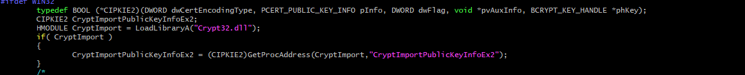
Decryption Stub Implementation of Cryptor
Bug fix for windows to import a public key
CryptImportKeyInfoEx2 Symbol was not exported properly in the windows next generation BCrypt library.
Manually import the symbol from crypt32.dll

Slide 67
Decryption Stub Implementation of Cryptor
2. Decode The Public Key

Slide 68
Decryption Stub Implementation of Cryptor
2. Decode The Public Key
a. The Public key is stored as a variable in an auto-generated header along with other information such as the IV

Slide 69
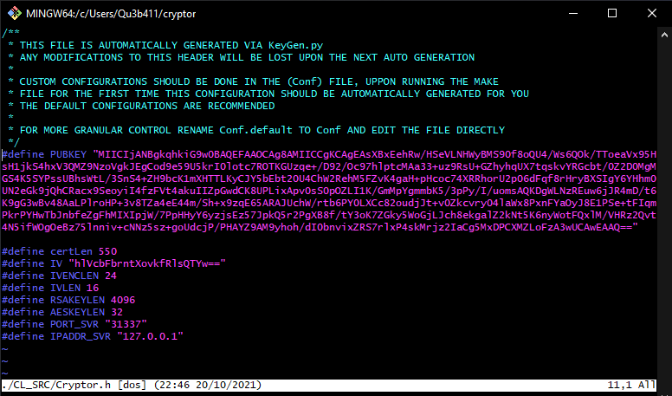
Decryption Stub Implementation of Cryptor
2. Decode The Public Key
a. The Public key is stored as a variable in an auto-generated header along with other information such as the IV

Slide 70
Decryption Stub Implementation of Cryptor
2. Decode The Public Key
a. The Public key is stored as a variable in an auto-generated header along with other information such as the IV
b. Base64 decode the public key

Slide 71
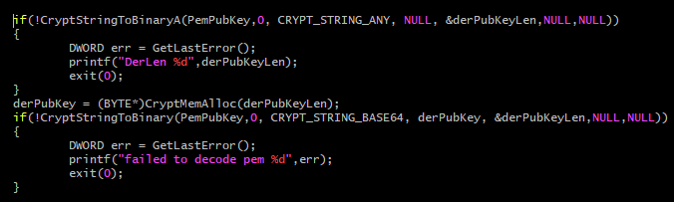
Decryption Stub Implementation of Cryptor
2. Decode The Public Key
a. The Public key is stored as a variable in an auto-generated header along with other information such as the IV
b. Base64 decode the public key

Slide 72
Decryption Stub Implementation of Cryptor
3. Finish loading the RSA cryptographic provider

Slide 73
Decryption Stub Implementation of Cryptor
3. Finish loading the RSA cryptographic provider
Declare a handle to the RSA cryptographic provider

Slide 74
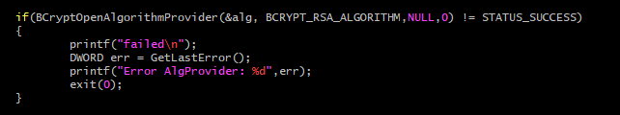
Decryption Stub Implementation of Cryptor
3. Finish loading the RSA cryptographic provider
Declare a handle to the RSA cryptographic provider

Slide 75
Decryption Stub Implementation of Cryptor
3. Finish loading the RSA cryptographic provider
Declare a handle to the RSA cryptographic provider
Decode the derPubKey into a PubKeyInfo object

Slide 76
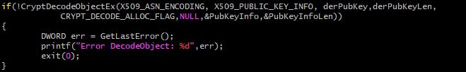
Decryption Stub Implementation of Cryptor
3. Finish loading the RSA cryptographic provider
Declare a handle to the RSA cryptographic provider
Decode the derPubKey into a PubKeyInfo object

Slide 77
Decryption Stub Implementation of Cryptor
3. Finish loading the RSA cryptographic provider
Declare a handle to the RSA cryptographic provider
Decode the derPubKey into a PubKeyInfo object
Get a handle to the freshly loaded rsa key

Slide 78

Decryption Stub Implementation of Cryptor
3. Finish loading the RSA cryptographic provider
Declare a handle to the RSA cryptographic provider
Decode the derPubKey into a PubKeyInfo object
Get a handle to the freshly loaded rsa key

Slide 79
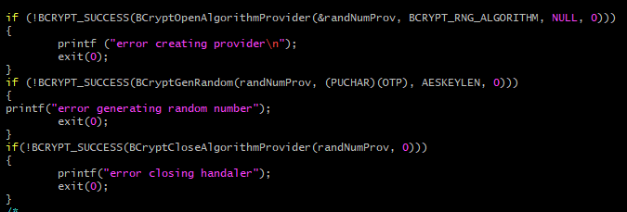
Decryption Stub Implementation of Cryptor
Client generates random OTP 16 bytes for aes 128 24 bytes for aes 192 32 bytes for aes 256

Slide 80
Decryption Stub Implementation of Cryptor
2. Client encrypts OTP with RSA

Slide 81
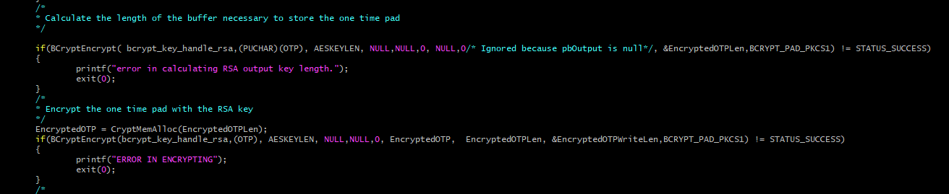
Decryption Stub Implementation of Cryptor
2. Client encrypts OTP with RSA

Slide 82
Decryption Stub Implementation of Cryptor
2. Client encrypts OTP with RSA 3. Client sends encrypted OTP to server

Slide 83
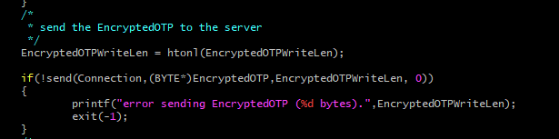
Decryption Stub Implementation of Cryptor
2. Client encrypts OTP with RSA 3. Client sends encrypted OTP to server

Slide 84
Decryption Stub Implementation of Cryptor
4. Server receives Encrypted OTP

Slide 85
Decryption Stub Implementation of Cryptor
4. Server receives Encrypted OTP 5. Server decrypts OTP

Slide 86
Decryption Stub Implementation of Cryptor
4. Server receives Encrypted OTP 5. Server decrypts OTP 6. Server XOR’s OTP against AES key for decrypting “.Payload” to generate the enciphered key

Slide 87

Decryption Stub Implementation of Cryptor
4. Server receives Encrypted OTP 5. Server decrypts OTP 6. Server XOR’s OTP against AES key for decrypting “.Payload” to generate the enciphered key

Slide 88
Decryption Stub Implementation of Cryptor
4. Server receives Encrypted OTP 5. Server decrypts OTP 6. Server XOR’s OTP against AES key for decrypting “.Payload” to generate the enciphered key 7. Server sends enciphered AES key back to the client

Slide 89
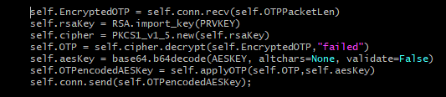
Decryption Stub Implementation of Cryptor
4. Server receives Encrypted OTP 5. Server decrypts OTP 6. Server XOR’s OTP against AES key for decrypting “.Payload” to generate the enciphered key 7. Server sends enciphered AES key back to the client

Slide 90
Decryption Stub Implementation of Cryptor
8. Client receives enciphered AES key

Slide 91
Decryption Stub Implementation of Cryptor
8. Client receives enciphered AES key 9. Client XOR’s the enciphered key with the OTP to get the AES key for decrypting the “.Payload” Section

Slide 92
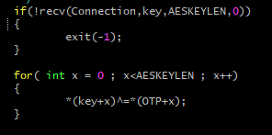
Decryption Stub Implementation of Cryptor
8. Client receives enciphered AES key 9. Client XOR’s the enciphered key with the OTP to get the AES key for decrypting the “.Payload” Section

Slide 93
Decryption Stub Implementation of Cryptor
10. Acquire Cryptographic handle for AES-CFB

Slide 94
Decryption Stub Implementation of Cryptor
10. Acquire Cryptographic handle for AES-CFB a. Decode the IV

Slide 95

Decryption Stub Implementation of Cryptor
10. Acquire Cryptographic handle for AES-CFB a. Decode the IV

Slide 96
Decryption Stub Implementation of Cryptor
10. Acquire Cryptographic handle for AES-CFB a. Decode the IV b. Open a handle to a cryptographic provider

Slide 97

Decryption Stub Implementation of Cryptor
10. Acquire Cryptographic handle for AES-CFB a. Decode the IV b. Open a handle to a cryptographic provider

Slide 98
Decryption Stub Implementation of Cryptor
10. Acquire Cryptographic handle for AES-CFB a. Decode the IV b. Open a handle to a cryptographic provider c. Set the AES algorithm to CFB mode with the correct Key and IV

Slide 99
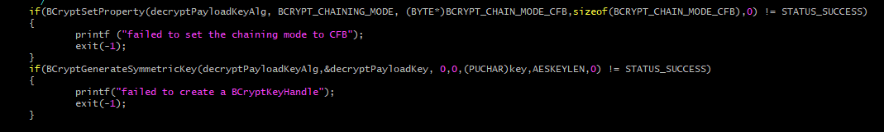
Decryption Stub Implementation of Cryptor
10. Acquire Cryptographic handle for AES-CFB a. Decode the IV b. Open a handle to a cryptographic provider c. Set the AES algorithm to CFB mode with the correct Key

Slide 100
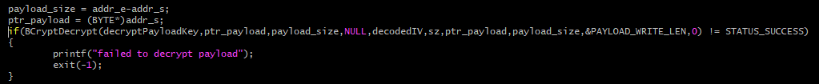
Decryption Stub Implementation of Cryptor
11. Finally we can decrypt the “.Payload” Section… so much easier in python

Slide 101
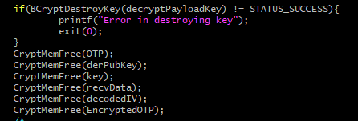
Decryption Stub Implementation of Cryptor
12. Client destroys AES Key and OTP

Slide 102

Demo Time

Slide 103
https://github.com/qu3b411/cryptor

